Slide 1
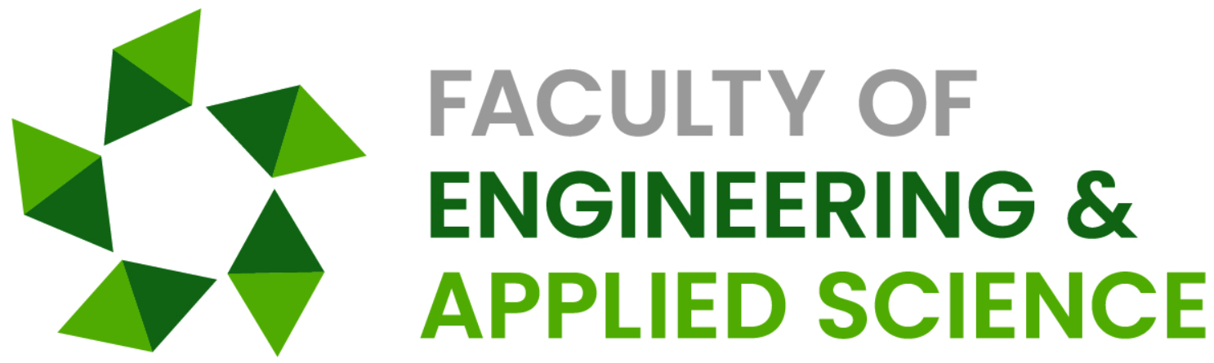

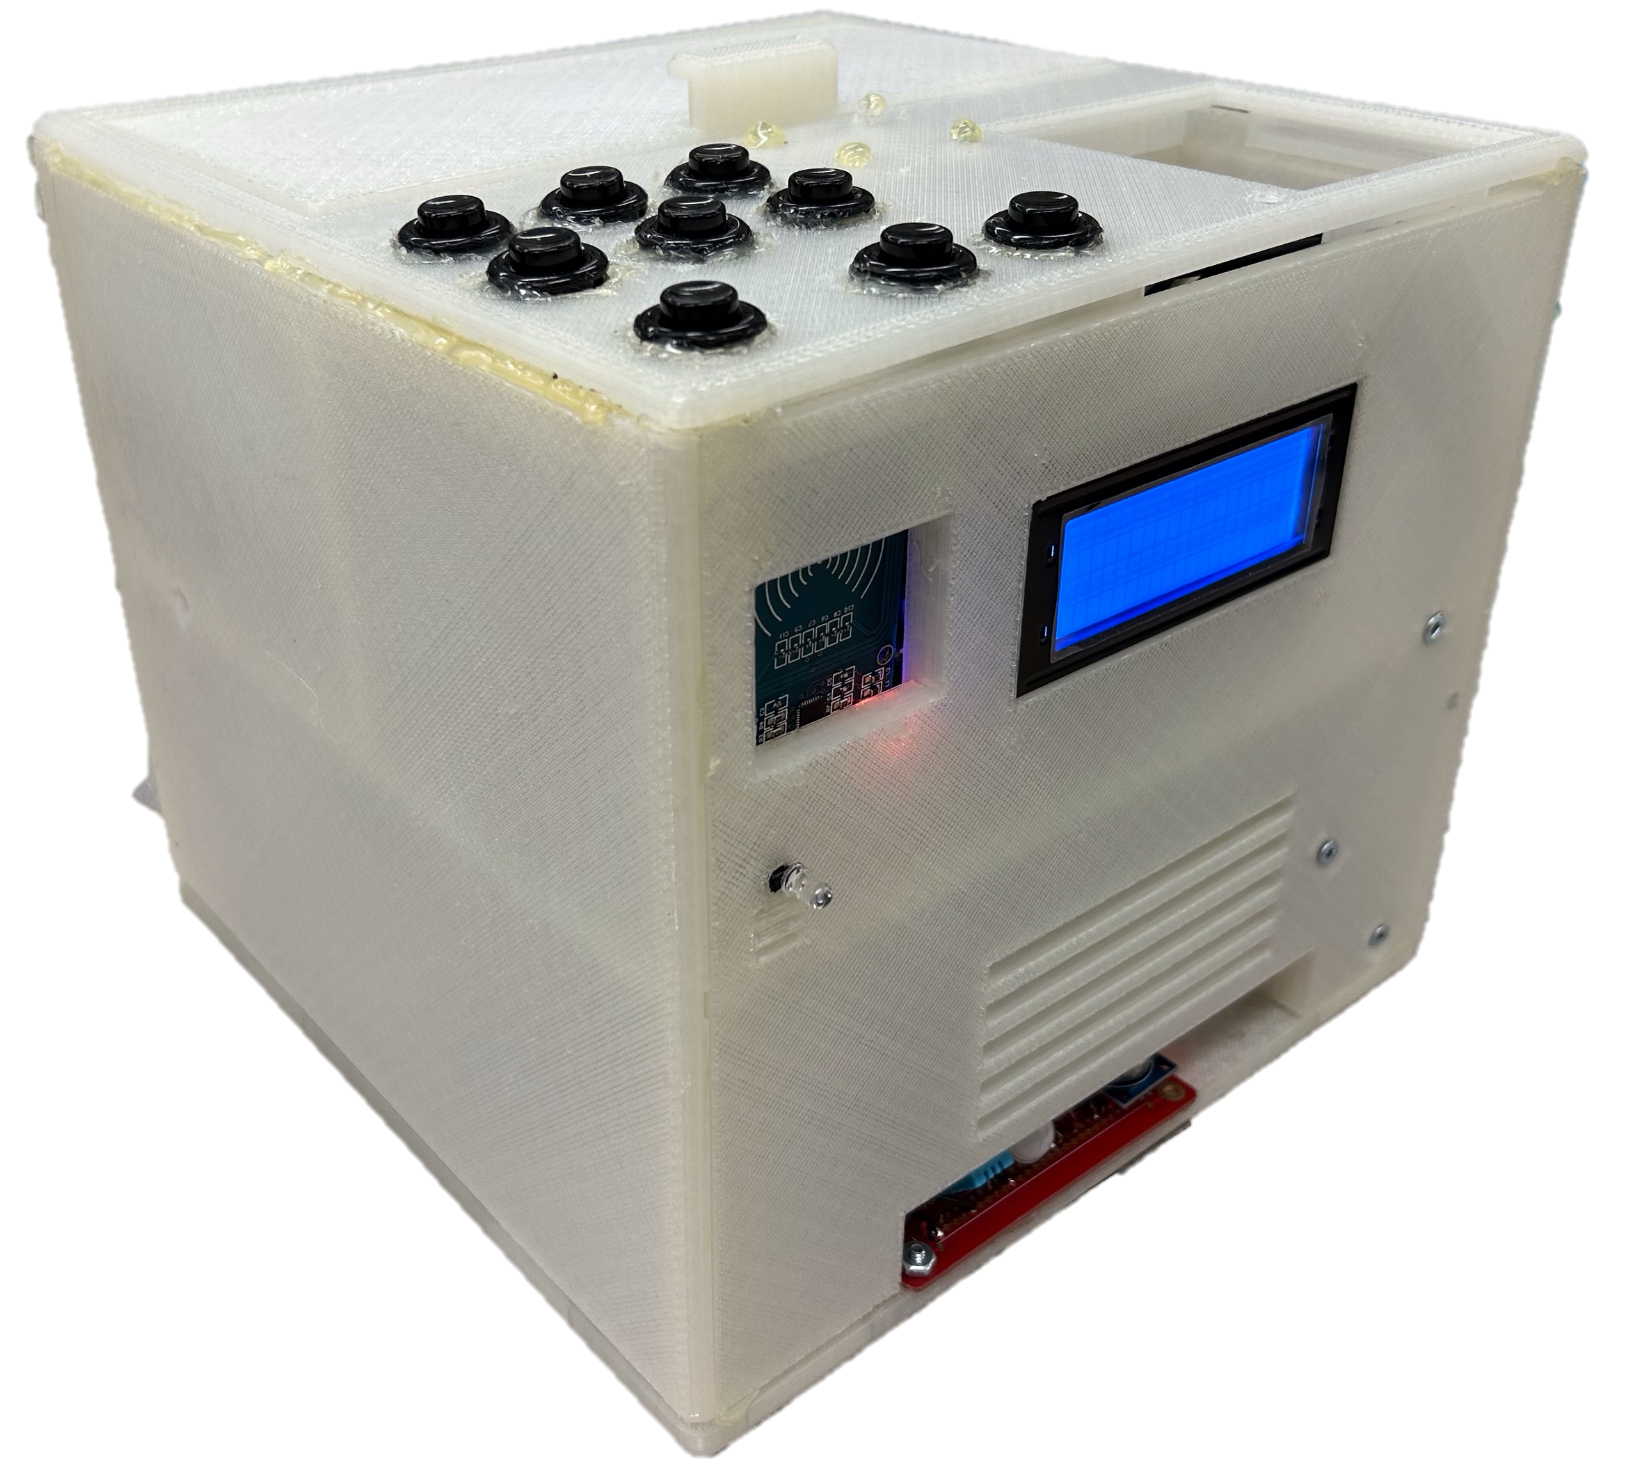
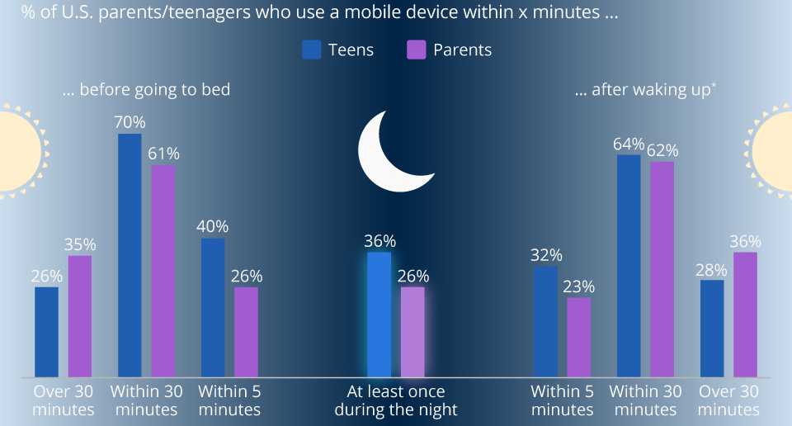
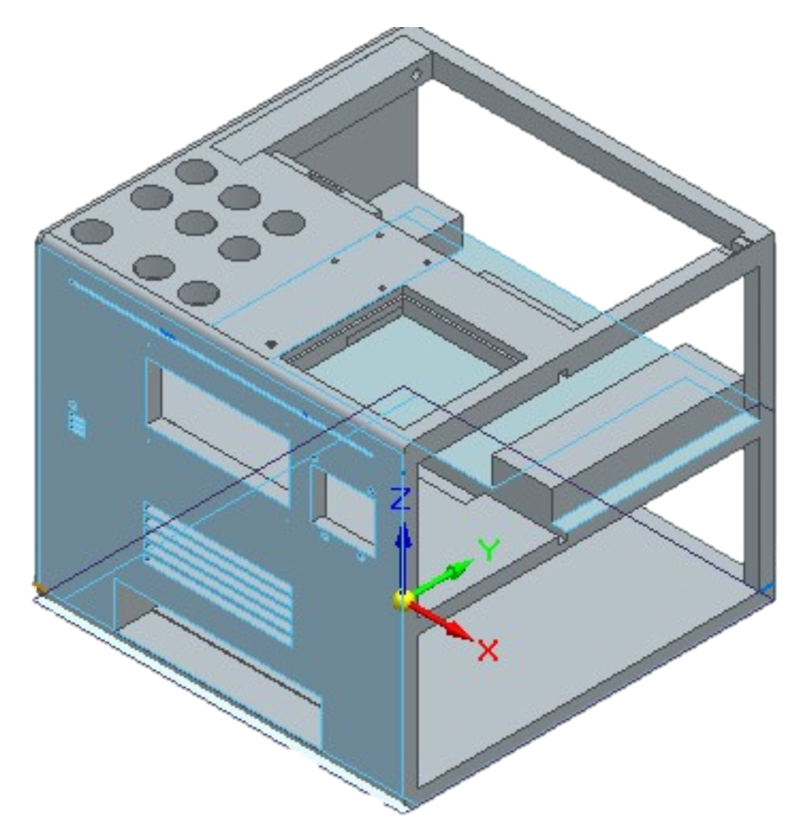
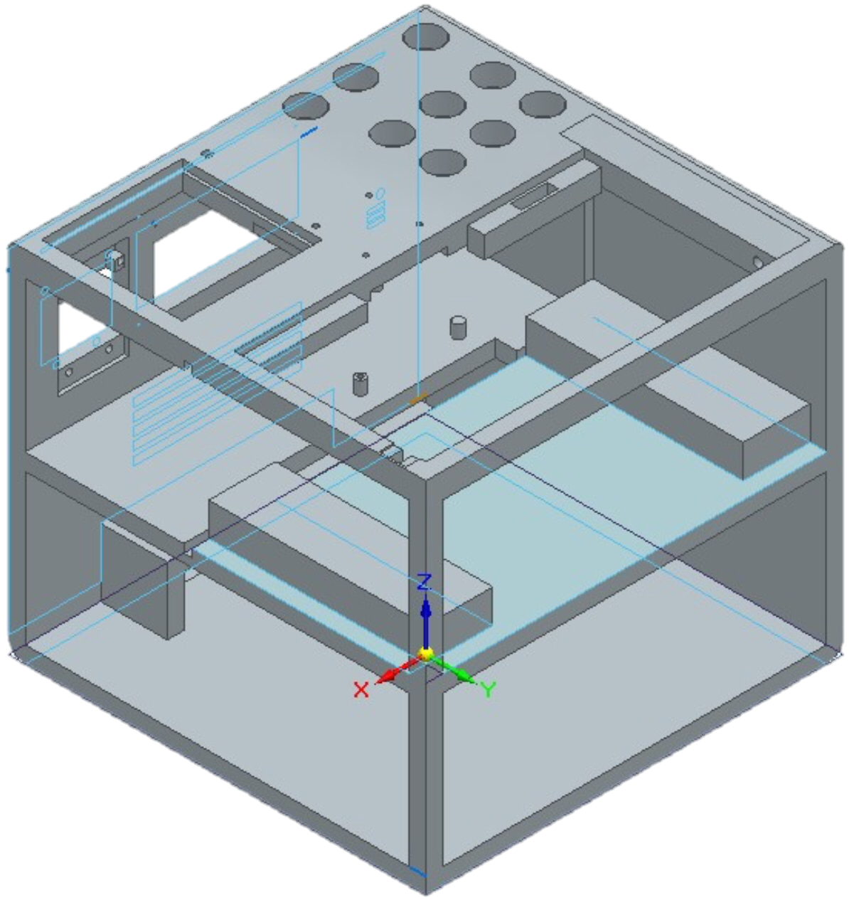


Well-Phone
Retrieved March 20, 2023, from https://www.uregina.ca/communications-marketing/visual-identity.html#fact_15_5
Retrieved March 20, 2023, from https://www.uregina.ca/communications-marketing/visual-identity.html#fact_15_5
Purpose
Aimed to Build a System that would:
Improve Long-term Quality of Life
Use a Consistent Reward Based System
Provide an Interactive Experience
Establish Healthy Habits for a Lifetime
Focus on the Users:
Physical Wellbeing
Mental Wellbeing
Emotional Wellbeing
Smartphone Lockbox
Benefits
Develop Positive Behaviours
Long-Term Gratification
Builds Healthy Habits into Adulthood
Recognize Feelings
Improves Physical Health
Better Sleep Quality
Next Steps
Turning the Well-Phone into a usable tool for children by:
Create app that controls Well-Phone Lockbox.
List activities/goals to set on app
Make rewards list that displays current streak and points to claim reward.
Features
Alarm Clock
Wireless Charging
UV Cleaning
Sleep Environment Sensor
Built-In AI Assistant
Physical, Mental and Emotional Activity Prompts
Automatic Locking Mechanism
EmotionMirror App Integration
Retrieved March 20, 2023, from https://www.statista.com/chart/12017/smartphone-use-in-the-morning-and-at-night/
COME SEE US IN ED 114!!
Curtis Ficor, Sharmarke Hassan, Jadon Donais

